Slide 1

Project Type - EDA
PRESENTED BY
SHRADDHA KAMBLE
GUIDE BY - ABHISHEK WAHWAL

Slide 2
TABLE OF
CONTENTS
Project Summary
Analysing Data
Data Cleaning
Data Wrangling
Guest Demographics
Financial Insights
Conclusion
Problem Statement
Column Names
Variables Descriptions
Basic Statistics
Cancellation Analysis
Weekly & Annual Dashboard

Slide 3
Summary of my project
The project with the goal of comprehending the Hotel Group's business.
The City Hotel and the Resort Hotel were the two hotels in this dataset.
The information covered the three years of 2015, 2016, and 2017. The revenue and booking details, including the number of days of stay, cancellations, and total number of guests, including children, are also available.
In addition, it details the length of time guests must wait to make reservations, how often they return, and what they want to eat. Additionally, the data allows us to analyze the nations from which reservations have been made.
On behalf of the resort and city hotel, we also serve as an agent and other channels that assist in business by making reservations for visitors.
The information is separated into city hotels and resort hotels. Thus, we are able to fairly compare the two. Prior to visualizing any data from the data set, we must perform data cleaning, which includes filling in any null values and removing any duplicate values. Next, we must perform data wrangling. We will conduct our analysis as well.

Slide 4
Problem Statement
The objective of Hotel Booking project is to Explore and analyze the data to discover important factors that govern the bookings.
This dataset includes booking details for both city and resort hotels, including the time of booking, the number of adults, kids, and/or infants, the number of parking spaces available, the agent who made the reservation, and other details.

Slide 5
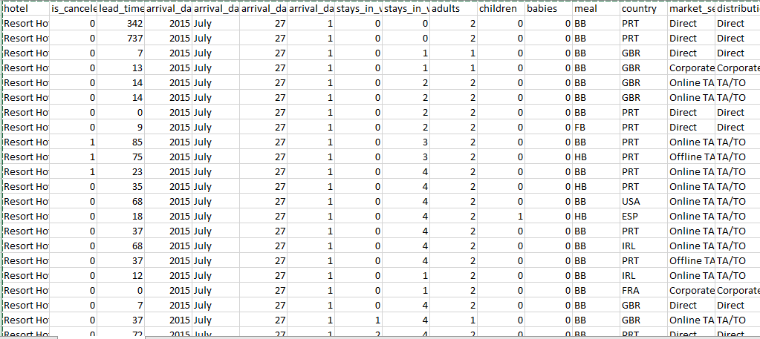
Dataset First View

Slide 6
Columns name we have 87220 ROWS and 30 columns
Booking ID meal assigned_room_type
Hotel country booking_changes
is_canceled market_segment deposit_type
lead_time distribution_channel agent
Arrival Date is_repeated_guest days_in_waiting_list
adults previous_cancellations customer_type
children previous_bookings_not_canceled Total stays
Babies reserved_room_type total_of_special_requests
Total People required_car_parking_spaces reservation_status_date
adr reservation_status satisfaction level

Slide 7
What did you know about your dataset?
In order to identify significant factors that impact hotel bookings, we must examine and analyze the provided dataset. The duplicate value count is 31994 rows.
There are 95% Null records in company column so that I have remove company column.
We use Booking Id as primary key.
We add satisfaction level column to improve the service quality.
There are separate columns called adults, children and babies that show the total number of people who are coming to visit, so instead of different columns will add these three in one called Total people.
After data cleaning and transforming, the dataset consists of 30 columns and 87,220 rows.

Slide 8
Variables Description
Booking Id- For sequence data
hotel - Type of hotel(Resort or City).
is_canceld - If there was booking cancel(0) or not(1).
lead time - The number of days between time books their room to arrive hotel.
Arrival Date - Year, Month & Date of visit the hotel
Total stays - No. of days including weekend spend by guest at hotel.
adults - No. of adults among guest.
children - No. of children among guest.
babies - No. of babies among guest.
meal - Type of meal booked by guest.
country - Country of guest.

Slide 9
Variables Description
market_segment - grouping into categories based on their booking patterns and travel habits.
distribution_channel - Name of booking distribution channel.
is_repeated_guest - If the booking was from repeated by guest(1) or not(0).
previous_cancelletions - No. of previous booking that were cancelled by the customer prior to the customer booking.
previous_booking_not_canceled - No. of previous booking that were not cancelled by the customer prior to the customer booking.
reserved_room_type - Code of room type reserved.
assigned_room_type - code of room type reserved.
booking_changes - No. of changes made to the booking.
Satisfaction Level- For better quality service

Slide 10
Variables Description
deposit_type - Type of the deposit made by the guest.
agent - Id of the agent who made the booking.
days_in_waiting_list - No. of days the booking on the waiting list.
customer_type - Type of customer, assuming one of four categories.
adr - (Average Daily Rate) dividing the sum of lodgging transaction by the total number of staying night.
required_car_parking_spaces - No. of car parking spaces required by the customer.
total_of_special_request - No. of special request made by the customer.
reservation_request - Reservation status
reservation_request_date - Date of last reservation status updated.

Slide 11
Data Wrangling
We already did some data cleaning before lets go for data Wrangling
*But we Adding*
Total staying days in hotels
Sum of adults+ child+ babies
We used Booking Id as primary key for sequence data
We remove error from children column
We create arrival date with using column [arrival_date_year, arrival_date_month, arrival_date_day _of_month ]
We remove the all duplicates value from entire database
For exact count of people, we create Total people from adults, children & babies column
Added Column Called Satisfaction Level of Customer Using the reserve_room_type+ assign_room_type column

Slide 12
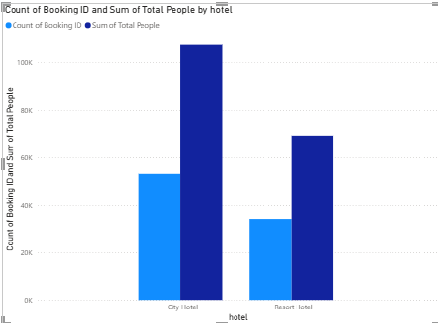
  BASIC STATISTICS
  FIND THE TOTAL NUMBER OF BOOKINGS.
  ALSO CALCULATE WHICH HOTEL TYPE HAS MORE GUESTS
107666
Here We have 4 Types of Data that's Why We Used Column Chart in this Question.
The Booking Ratio of Hotels is as follows:-
A. Resort Hotel : 33951
B. City Hotel : 53269
The sum of total people of Hotel is As Follows:-
A. Resort Hotel : 69174
B. City Hotel : 107666
69174
53269
33951

Slide 13
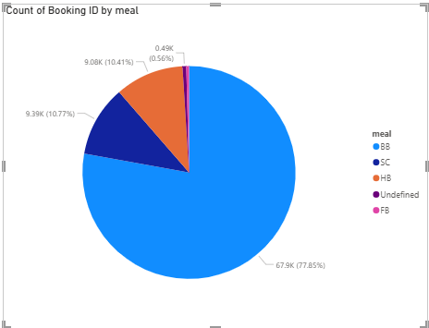
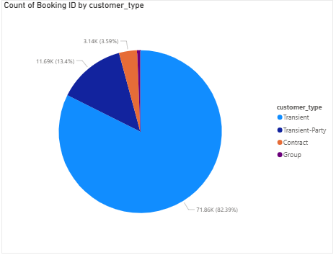
  BASIC STATISTICS
  COUNT OF BOOKING ID BY MEAL
  COUNT OF BOOKING ID BY CUSTOMER TYPE.

Slide 14
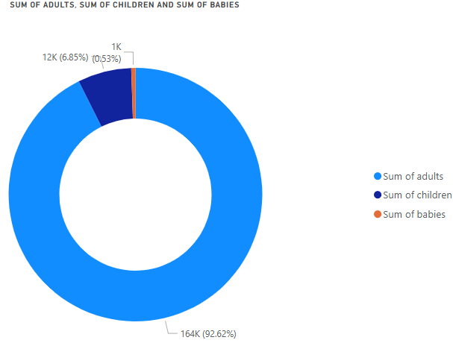
Guest Demographics
In this chapter, we have covered the topic of Guest Demographics, exploring aspects such as the age group of customers making bookings.
A total of 1,63,787 adults, 12,116 children, and data for 937 babies indicate bookings at the hotels.
In this context, we have utilized a donut chart to represent data in three categories.

Slide 15
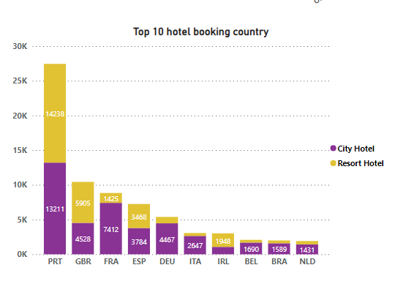
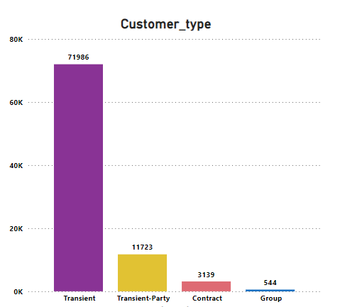
Guest Demographics variations in booking ratios across different countries, and the types of customers engaging in bookings.
We have utilized data from countries worldwide and focused on presenting the top 10 countries, as indicated below.
And We Found PRT(Portugal) is Highest booking have in this data.(I.E.27449)
In this section, we have identified the types of customers, highlighting that transient customers account for the highest number of bookings.

Slide 16
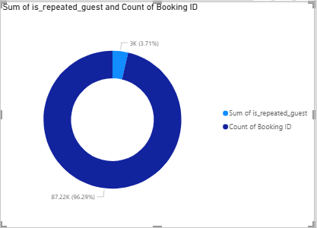
PROPORTION OF REPEATED
GUESTS
Based on the Donut chart, only a tiny portion of guests are repeat visitors, about 3.76%.
Based on this observation, we can understand that hotels need to find solutions to encourage more guests to come back to the hotels.

Slide 17
Cancellation Analysis:
  Find out the most typical cancellation reasons.
  Changes in plans
  Budget constraints
  Health issues
  Errors in reservations,
  Negative reviews or ratings,

Slide 18
Cancellation Analysis:
  To avoid the factors of cancellation we can suggest following things
  Changes in plans- We can Offer flexible date modification instead of cancellation
  Budget constraints- We can Introduce best-price guarantee or discount
  Health issues -Allow medical cancellation with proof
  Errors in reservations- Enable easy same-day corrections
  Negative reviews or ratings- Respond to bad reviews quickly

Slide 19
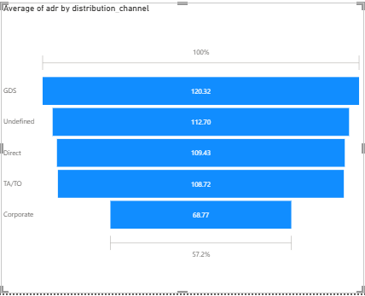
Financial Insights
Calculate the average daily rate (ADR) and its distribution channels.
This chart indicates the revenue generated through various distribution channels, revealing that the highest average revenue collection of $120.32 occurred through GDS.
The management should give attention on corporate channel to grow ADR

Slide 20
WEEKLY AND ANUAL
INSIGHTS
DASHBOARD

Slide 21
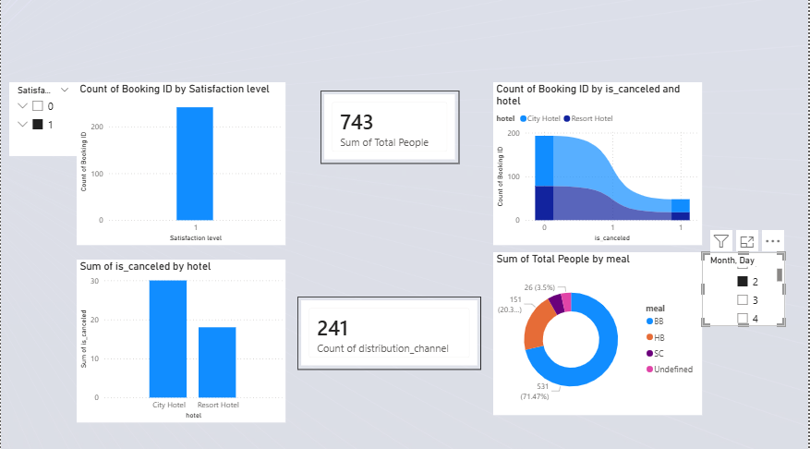
Weekly Dashboard

Slide 22
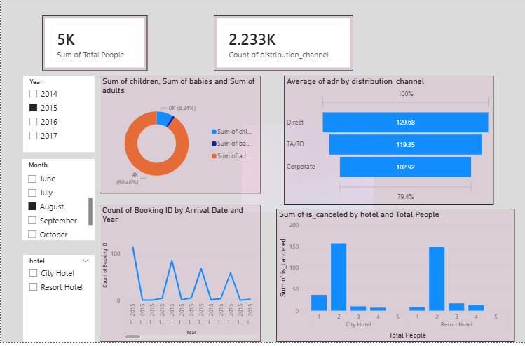
Annual Dashboard

Slide 23
Conclusion
The analysis clearly shows that resort hotels outperform city hotels in terms of advance bookings and lower cancellation rates, while city hotels lead in overall booking volume. Hotel demand is strongly influenced by seasonal patterns, with peak reservations occurring during the mid-year months, emphasizing the importance of effective capacity and resource management.
Customer behavior analysis reveals that meal plans, booking channels, and market segments play a crucial role in hotel performance and revenue generation. Furthermore, the low proportion of repeat guests highlights an opportunity for hotels to strengthen customer engagement strategies and loyalty programs.
Overall, this project demonstrates that exploratory data analysis (EDA) is a powerful approach for transforming raw reservation data into actionable insights, enabling hotels to make data-driven operational and strategic decisions.

Slide 24


Slide 25
* Thankyou *

